Slide 1

Module ten: Big Data and information ethics
CIS 303 – Prof. C. R. Johnson

Slide 2
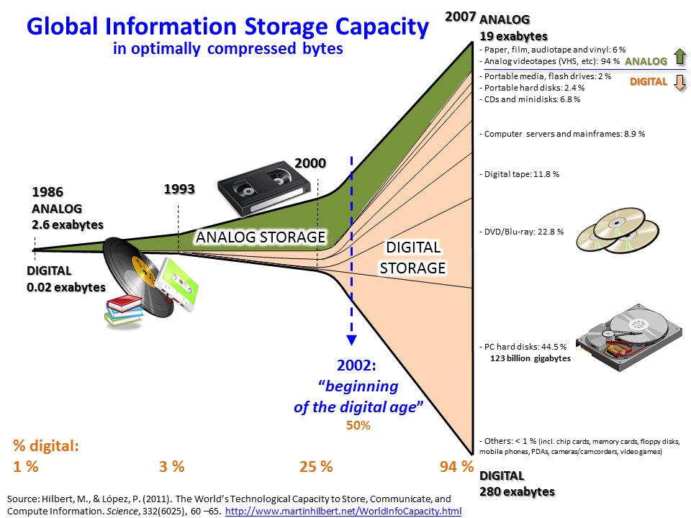

Slide 3
What is big data?
The term “Big Data” does not necessarily refer to the amount of data we’re talking about – although it is a LOT of data.
It refers to a fundamental shift in the way that data is processed.
Historically, structured data has typically been the focus of most enterprise analytics, and has been handled through the use of the relational data model. Recently, the quantity of unstructured data, such as micro-texts, web pages, relationship data, images and videos, has exploded, and the trend indicates an increase in the incorporation of unstructured data to generate value.

Slide 4
Scaling up, or scaling across
Vertical scaling implies increasing the system parameters of processing speed, storage, and memory for greater performance. This approach is limited by physical capabilities whose improvements have been described by Moore’s Law, requiring ever more sophisticated elements (e.g., hardware, software) that add time and expense to the implementation.
The alternate method is to use horizontal scaling, to make use of distributed individual resources integrated to act as a single system. It is this horizontal scaling that is at the heart of the Big Data revolution.

Slide 5
3 v… No, 4… Wait… 5… 6?
Big Data refers to the inability of traditional data architectures to efficiently handle the new datasets. Characteristics of Big Data that force new architectures are:
Volume (i.e., the size of the dataset);
Variety (i.e., data from multiple repositories, domains, or types);
Velocity (i.e., rate of flow); and
Veracity (i.e. reliability of the data)
Notes:
Variability (i.e., the change in other characteristics).
Value - The worth in information that can be achieved by the processing and analysis of large datasets. Value also can be measured by an assessment of the other qualities of big data.[39] Value may also represent the profitability of information that is retrieved from the analysis of big data

Slide 6
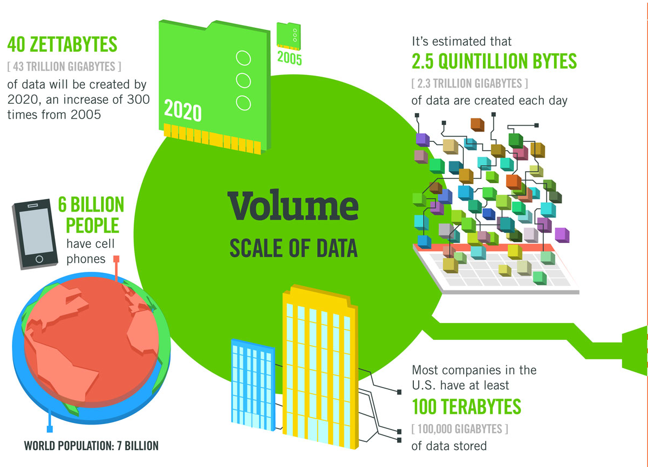

Slide 7
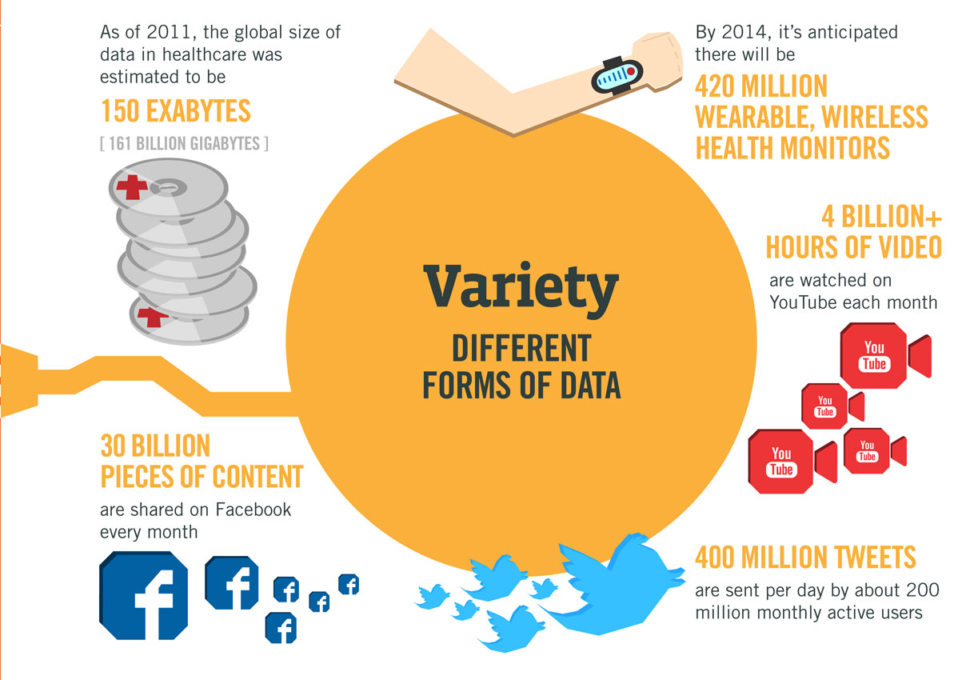

Slide 8
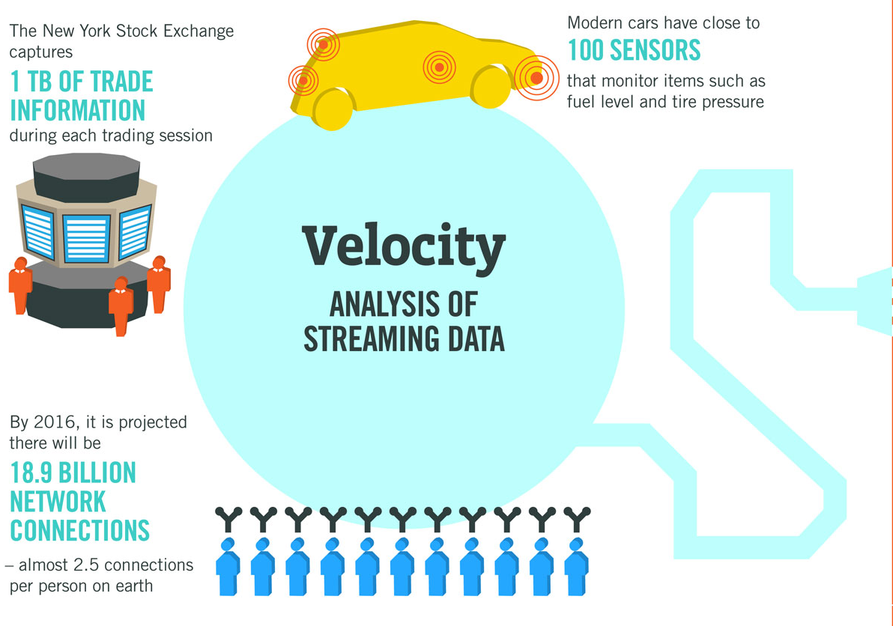

Slide 9
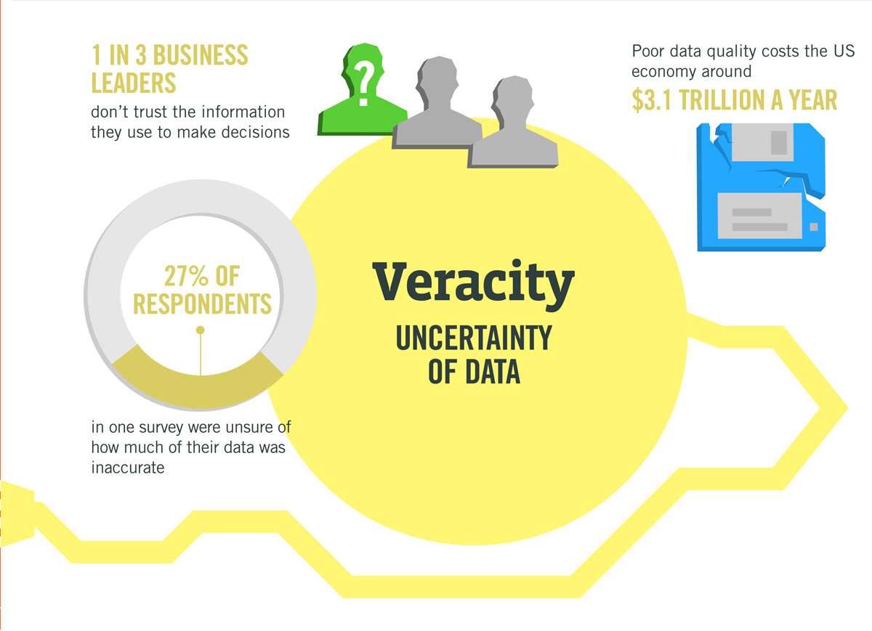

Slide 10
Another v: Vulnerability
Variety: Retargeting traditional relational database security to non-relational databases has been a challenge. An emergent phenomenon that has gained considerable importance is the ability to infer identity from anonymized datasets by correlating with apparently innocuous public databases.
Volume: The volume of Big Data has necessitated storage in multitiered storage media. The movement of data between tiers has led to a requirement of systematically analyzing the threat models and research and development of novel techniques.
Velocity: As with non-relational databases, distributed programming frameworks such as Hadoop were not developed with security as a primary objective.
Variability: Security and privacy requirements can shift according to the time-dependent nature of roles that collected, processed, aggregated, and stored it. Governance can shift as responsible organizations merge or even disappear

Slide 11
Players in big data
The (US) Federal Trade Commission as "companies that collect information, including personal information about consumers, from a wide variety of sources for the purpose of reselling such information to their customers for various purposes, including verifying an individual’s identity, differentiating records, marketing products, and preventing financial fraud".

Slide 12
Players in big data
Information broker is sometimes abbreviated to IB, and other terms used for information brokers include data brokers, independent information specialists, information or data agents, data providers, data suppliers, information resellers, data vendors, syndicated data brokers, or information product companies.
Information consultants, freelance librarians, and information specialists are also sometimes termed information brokers

Slide 13
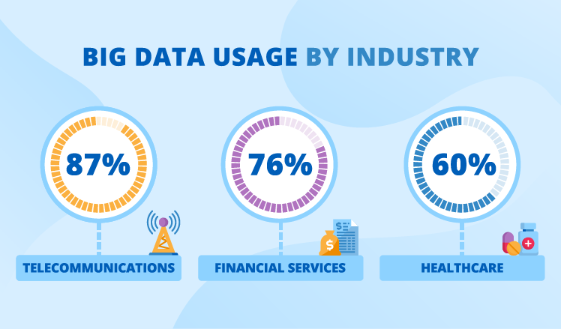

Slide 14
The promise of prediction:
The availability of vast data resources carries the potential to answer questions previously out of reach, including the following:
How can a potential pandemic reliably be detected early enough to intervene?
Can new materials with advanced properties be predicted before these materials have ever been synthesized?
How can the current advantage of the attacker over the defender in guarding against cybersecurity threats be reversed?

Slide 15
The promise of prediction:
Despite widespread agreement on the inherent opportunities and current limitations of Big Data, a lack of consensus on some important fundamental questions continues to confuse potential users and stymie progress:
What attributes define Big Data solutions?
What are the essential characteristics of Big Data environments?
How do these environments integrate with currently deployed architectures?
What are the central scientific, technological, and standardization challenges that need to be addressed to accelerate the deployment of robust Big Data solutions?

Slide 16
the Big Data R&D Initiative
Within this context, on March 29, 2012, the White House announced the Big Data Research and Development Initiative. The initiative’s goals include helping to accelerate the pace of discovery inscience and engineering, strengthening national security, and transforming teaching and learning by improving the ability to extract knowledge and insights from large and complex collections of digital data

Slide 17
The downside
This also means a re-opening of the technology disparity.
1990-2010 saw a lifting of many into the technical revolution, mobile devices and broadband Internet.
But this mean more unstructured data to harness.
Which means the potential this data represents is trapped behind those with the resources to field data warehouses and processing technologies.

Slide 18
Information Ethics vs data ethics
Information ethics, to this point, has been concerned primarily with intellectual property, information professional conduct, and access to technology.
Data ethics refers to systemizing, defending, and recommending concepts of right and wrong conduct in relation to data, in particular personal data. This pertains mostly to data brokers, corporations, and governments.

Slide 19
Information Ethics: Censorship
Censorship is an issue commonly involved in the discussion of information ethics because it describes the inability to access or express opinions or information based on the belief it is bad for others to view this opinion or information. Sources that are commonly censored include books, articles, speeches, art work, data, music and photos.
Censorship can be perceived both as ethical and non-ethical in the field of information ethics.

Slide 20
For Censorship
Those who believe censorship is ethical say the practice prevents readers from being exposed to offensive and objectionable material. Topics such as sexism, racism, homophobia, and anti-semitism are present in public works and are widely seen as unethical. There is concern regarding the exposure of these topics to the world, especially the young generation.
The idea is that the act of censorship is an ethical way to provide information to the public that is considered morally sound, allowing positive ethics instead of negative ethics to be dispersed. Society has an "ethical duty" to protect minds, particularly young people, to prevent the others from adopting the unethical ideas and behaviors.

Slide 21
Against Censorship
John Stuart Mill argued censorship is unethical because it goes directly against the moral concept of utilitarianism.
Humans are unable to have true beliefs when information is withheld from the population via censorship and acquiring true beliefs without censorship leads to greater happiness. According to this argument, true beliefs and happiness (of which both concepts are considered ethical) cannot be obtained through the practice of censorship. Censorship harms students and is morally wrong because they are unable to know the full extent of knowledge available to the world.
Censorship is also inherently abusive, infantilizing people and regulates morality. See: Schools removed information about evolution from libraries and curriculums due to the topic conflicting with religious beliefs. In this case, advocates against ethics in censorship argue it is more ethical to include multiple sources information on a subject, such as creation, to allow the reader to learn and decipher their beliefs.

Slide 22
Information ethics: piracy
Illegal downloading has also caused some ethical concerns and raised the question whether digital piracy is equivalent to stealing or not. When asked the question "Is it ethical to download copyrighted music for free?" in a survey, 44 percent of a group of primarily college-aged students responded "Yes."
Illegal downloading as equivalent to common theft is problematic, because clear and morally relevant differences can be shown between stealing someone’s handbag and illegally downloading a television series. However, even the hard liners for open information agree consumers should try to respect intellectual property unless doing so imposes unreasonable cost on them.
In an article titled "Download This Essay: A Defence of Stealing Ebooks", Andrew Forcehimes argues that the way we think about copyrights is inconsistent, because every argument for (physical) public libraries is also an argument for illegally downloading ebooks and every argument against downloading ebooks would also be an argument against libraries.

Slide 23
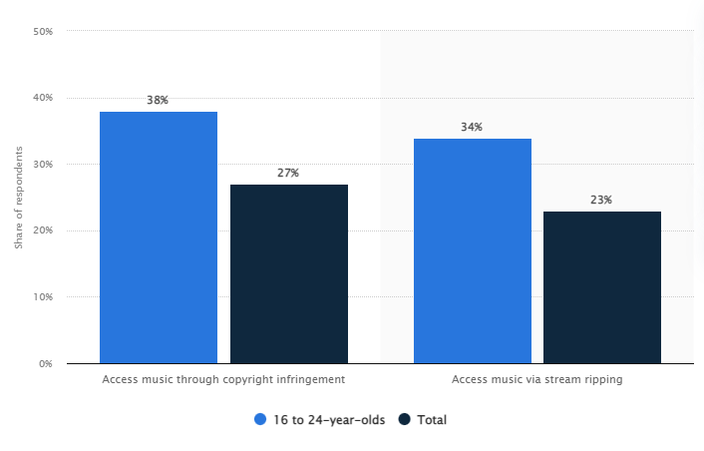
Notes:
Share of Gen Z vs. total internet users who access music through copyright infringement or stream ripping worldwide as of May 2019

Slide 24
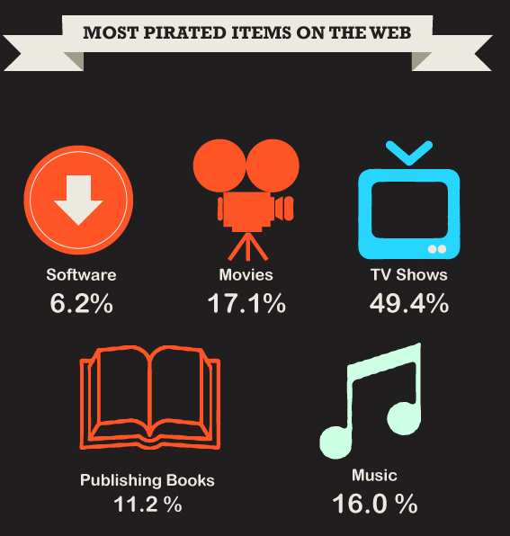
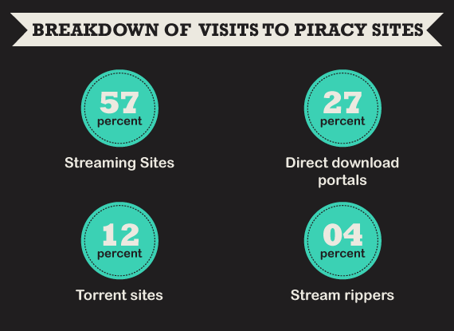

Slide 25
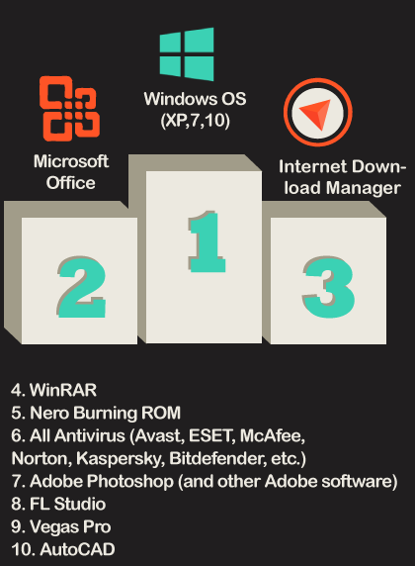
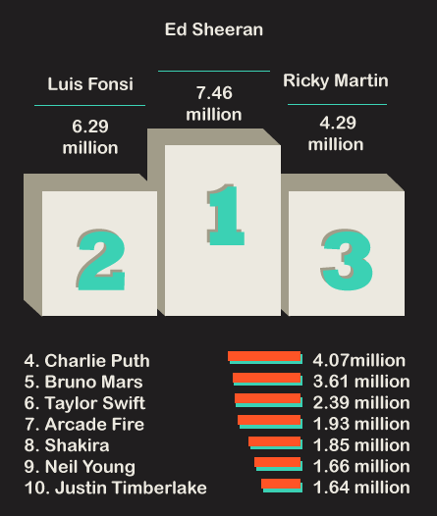
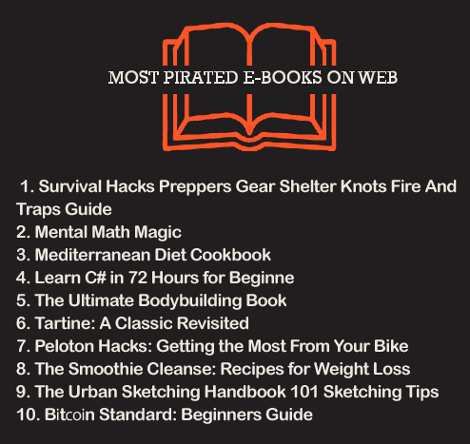

Slide 26
Information Ethics: Digital divide
An issue specific to the ethical issues of the freedom of information is what is known as the digital divide. This refers to the unequal socio-economic divide between those who had access to digital and information technology, and those who have had limited or no access at all.
This gap of access between countries or regions of the world is called the global digital divide.

Slide 27
Information Ethics: Regulated content
Sexuality / Pornography
Gambling

Slide 28
Codes of Ethics: RFC 1087
In January 1989, the Internet Architecture Board (IAB) in RFC 1087, titled "Ethics and the Internet," defines an activity as unethical and unacceptable if it:
Seeks to gain unauthorized access to the resources of the Internet.
Disrupts the intended use of the internet.
Wastes resources (people, capacity, computer) through such actions.
Destroys the integrity of computer-based information, or
Compromises the privacy of users.

Slide 29
Codes of Ethics: The Code of Fair Information Practices
Based on five principles outlining the requirements for records keeping systems. This requirement was implemented in 1973 by the U.S. Department of Health, Education and Welfare.
There must be no personal data record-keeping systems whose very existence is secret.
There must be a way for a person to find out what information about the person is in a record and how it is used.
There must be a way for a person to prevent information about the person that was obtained for one purpose from being used or made available for other purposes without the person's consent.
There must be a way for a person to correct or amend a record of identifiable information about the person.
Any organization creating, maintaining, using, or disseminating records of identifiable personal data must assure the reliability of the data for their intended use and must take precautions to prevent misuses of the data.

Slide 30
Codes of Ethics: (ISC)2 Code of Ethics
Code of Ethics Preamble:
The safety and welfare of society and the common good, duty to our principles, and to each other, requires that we adhere, and be seen to adhere, to the highest ethical standards of behavior. Therefore, strict adherence to this Code is a condition of certification.
Code of Ethics Canons:
Canon One: Protect society, the common good, necessary public trust and confidence, and the infrastructure.
Canon Two: Act honorably, honestly, justly, responsibly, and legally.
Canon Three: Provide diligent and competent service to principles.
Canon Four: Advance and protect the profession

Slide 31
Data Ethics
Data ethics is concerned with the following principles:
Ownership - Individuals own their own data
Transaction transparency - If an individual's personal data is used, they should have transparent access to the algorithm design used to generate aggregate data sets
Consent - If an individual or legal entity would like to use personal data, one needs informed and explicitly expressed consent of what personal data moves to whom, when, and for what purpose from the owner of the data
Privacy - If data transactions occur all reasonable effort needs to be made to preserve privacy
Currency - Individuals should be aware of financial transactions resulting from the use of their personal data and the scale of these transactions
Openness - Aggregate data sets should be freely available

Slide 32
Data abuse
Discrimination
Predictive analytics, or breach of confidentiality used to defame or demean individuals.
Identity Theft
Exposure of personal information leading to financial losses or loss of public trust.
Loss of Anonymity
Exposure of data leads to re-identification or provided the basis for disambiguation.
Sovereign Exemptions
Government agencies collecting data with impunity, without governing law or public knowledge.
Data Brokerage
Big data markets engaged in selling data that is outdated, inaccurate, and/or unprotected.
Misinterpretation
Utilizing data with faulty methodologies or where the integrity has not been preserved. Collecting MORE data instead of high-quality data.

Slide 33
Data abuse
Dating Apps: OKCupid was sharing users’ location and information about their sexual desires, alcohol use, political views, and ethnicity with third parties, while Tinder was sharing users’ location, age, gender, and partner preference. Grindr was sharing its users’ HIV status and personally identifying information.
Menstrual Trackers: MyDays cycle tracking app are continually having their location tracked. Their location and personal information is then shared with a company that markets users’ personal life details like “User has arrived at a clinic” or “User might be unfit to drive due to sleep deprivation” to insurance companies.

Slide 34
Data sovereignty
Data sovereignty refers to a government's control over the data that is generated and collected within a country. The issue of data sovereignty was heightened when Edward Snowden leaked US government information about a number of governments and individuals whom the US government was spying on. This prompted many governments to reconsider their approach to data sovereignty and the security of their citizens' data.
The restriction of data flow can hinder scientific discovery, to the disadvantage of many but particularly, developing countries. This is of considerable concern to big data ethics because of the tension between the two important issues of cybersecurity and global development.

Slide 35
Notable concerns
Data brokers in the United States include Acxiom, Experian, Epsilon, CoreLogic, Datalogix, Intelius, PeekYou, Exactis, and Recorded Future.
Acxiom claims to have files on 2.5 billion people, with about 11,000 data points per consumer. The company Oracle has publicly noted it has connections with 80 data broker companies.
The US Department of Homeland Security has purchased cell phone location data and home utility data from data brokers to facilitate deportations. The Federal Bureau of Investigation (FBI) has purchased personal data from the company Venntel. Under both of these circumstances, a warrant is not required to acquire this data, due to the fact that it is "open source" or "commercially obtained". Use of the data also has implications in background checks (used in rent/housing and job applications).

Slide 36
Notable Concerns
In 2017, Cambridge Analytica claimed that it has psychological profiles of 220 million United States citizens, based on 5,000 separate data sets, with another source reporting 230 million. A scandal emerged after it was found that after 270,000 Facebook users consented to sharing their data, data was scraped from about 50 million profiles on the social media platform. This was seen as breach of trust by Facebook.
In 2018, American companies spent $19 billion acquiring and analyzing consumer data, according to the Interactive Advertising Bureau.
In 2021, The Pillar outed a Catholic priest by purchasing data from a data broker including data usage from Grindr.

Slide 37
Notable Concerns
In fact, governments in general seem to be the actual consumers of most big data.
The Integrated Joint Operations Platform (IJOP, 一体化联合作战平台) is used by the government to monitor the population, particularly Uyghurs. Biometrics, including DNA samples, are gathered through a program of free physicals.
China has recent publicly revealed its social credit system, base don large dataset on citizens. The Social Credit System, now being piloted in a number of Chinese cities.

Slide 38
Notable Concerns
The biggest consumer of big data in the USA is likely the US Government, which we did not actually notice until the Snowden leak. Now we know the National Security Administration (NSA), which monitors the activities of the Internet constantly in search for potential patterns of suspicious or illegal activities their system may pick up.
2013 mass surveillance leak

Slide 39

Snowden effect
“If you give up your privacy, you give up your power.” – Thor Benson.
Even if you’re not familiar with the leaks specifically, you have no doubt felt the effects. Or at least seen memes like these:

Slide 40
Snowden effect
Snowden revealed that the GCHQ had a whole list of Smurf tools, each with its own use and purpose. Here are some examples:
Dreamy Smurf – Has the ability to turn phones on or off remotely
Nosey Smurf – Has the ability to make use of the phone’s microphone to listen to conversations and noise in the local area.
Tracker Smurf – Has the ability to track your position precisely
Paranoid Smurf – Works to hide the activities of the other Smurfs to prevent detection

Slide 41
XKeyScore
“You could read anyone's email in the world, anybody you've got an email address for. Any website: You can watch traffic to and from it. Any computer that an individual sits at: You can watch it. Any laptop that you're tracking: you can follow it as it moves from place to place throughout the world. It's a one-stop-shop for access to the NSA's information. ... You can tag individuals ... Let's say you work at a major German corporation and I want access to that network, I can track your username on a website on a forum somewhere, I can track your real name, I can track associations with your friends and I can build what's called a fingerprint, which is network activity unique to you, which means anywhere you go in the world, anywhere you try to sort of hide your online presence, your identity.”

Slide 42
PRISM
PRISM was the code name given to an NSA program in which the agency could effectively demand data from major tech and internet companies like Google, Facebook, and Apple.
The sorts of content the NSA could collect included search histories, downloads, emails, and more. The focus of the program was to track potential terrorism suspects, but the system effectively allows for the data of almost any internet user to be taken, making it a huge threat to people’s privacy.

Slide 43
ANT Tools
SURLYSPAWN – Able to log keystrokes on a computer and transmit them wirelessly, even when the computer isn’t connected to the internet
CANDYGRAM – Able to imitate a GSM cell phone tower to monitor cell communications
FIREWALK – Designed to look just like a regular RJ45 internet socket, this tool can inject and monitor device data via radio waves
MONKEYCALENDAR – Able to transmit a cell phone’s geolocation via a secret text message
COTTONMOUTH – Designed to look like USB and Ethernet connectors, these tools can hack into computers and provide remote access

Slide 44
Big Data Tool
Boundless Informant (or BOUNDLESSINFORMANT) is the code name given to a big data analysis tool used by the NSA. This tool basically tracks all of the metadata collected by the NSA around the world and makes a kind of ‘heatmap’ of that data to show where it came from and which countries are targeted most frequently.
The tool showed that billions of pieces of information were being collected every single month, and it also showed that several billion pieces were being taken from citizens of the United States. This was despite the fact that the NSA had specifically stated to Congress that it did not gather data on millions of American citizens and didn’t even have the capacity to do so.

Slide 45
United States v. Moalin
An appeal by four Somali individuals who had been convicted based on data obtained through bulk telephone data collection by the National Security Agency. The appeals court upheld their convictions, but also ruled that bulk telephone data collection by the National Security Agency, the details of which were leaked by Edward Snowden, were illegal.
The case proceeded slowly because of classified data, taking seven years.
On September 2, 2020, a unanimous decision by the three-judge panel was published. They ruled that bulk collection of telephone data was illegal because it violated the Foreign Intelligence Surveillance Act. They also ruled that it was possibly unconstitutional.
However, this decision may not have had a major effect, because the bulk telephone data collection program involved in the case ended in 2015, and the program that replaced it was also shut down.

